Slide 1
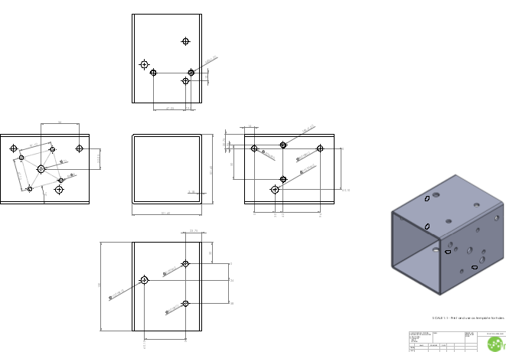
Bottom
Be sure to choose ‘actual size’ when printing from adobe reader; make sure to disable any scaling effects from the printing options
Front (stepper side)
Rear
Top

